Slide 1

Poster Presentation
IOS Conference Belfast

Slide 2























M McFadden, S Kirk, B Ugurlu, C Mun Soong, C Smyth
Aetiology of hearing loss March 21- April 23
WHSCT SSNHL Pathway
90
79
80
Introduction
70
Patient Referred ? SSNHL
60
The WHSCT sudden hearing loss pathway is unique in that it makes use of
remote access to audiology ensuring early definitive diagnosis of SSNHL. This
ensures appropriate steroid prescribing and redirection of patients with
conductive or chronic hearing loss. This study evaluates the efficacy of the
50
40
30
30
20
7
Patient Triaged ( direct to 1
on call via
10
4
2
1
1
st
0
Methods
First on call contact patient and take history
Aetiology of hearing loss March 21- April 23
Retrospective review of patients outpatient clinic record, their electronic care
record, departmental handover sheet and relevant imaging.
Figure 1: Bar graph demonstrating aetiology of hearing loss March 21- April 23
referrel source
Figure 2: Pie chart
demonstrating source
Audiology emailed to arrange audiogram (
Aim <24 hours)
Results
• 125 patients referred to the WHSCT with a queried SSNHL from March 2021
until April 2023
Local Audio department contact patient and
upload audiogram to ECR
pathology ( see figure 1)
First on call check ECR and review
audiograms patients then contacted in line
ED
GP
other ward
self
uknown
20
Time from referal until 1st Audiogram
• 88% of referrals triaged within 48 hours
18
16
audiogram within 10 days ( see figure 3)
1) SSNHL < 2 weeks; PO Steroid 1mg/kg , MRI
IAM and 2 week audio
14
12
2) SSNHL >2 weeks/ Fail PO steroids ;
10
patients prior to audiogram
IT Dex x3 in 1 week
8
3) Conductive: Urgent ENT OPD
6
patients progressing to Intra-tympanic (IT) Dexamethasone.
4
2
OP Follow up with consultant otologist for
final audiogram, MRI results +- Hearing
0
steroid, 10 required IT steroid.
• 83% had further follow up in clinic.
Figure 3: Bar graph demonstrating time in days from referral to first audiogram
Conclusions
The current pathway affords prompt access to audiograms and so early diagnosis
of SSNHL. Stricter adherence to the pathways treatment protocol and optimised

Slide 3
Poster Presentation
IOS Conference Belfast

Slide 4



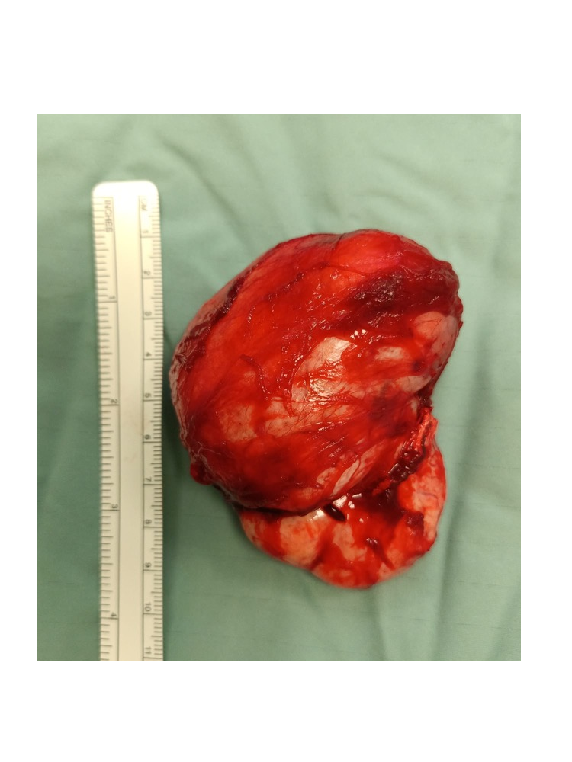
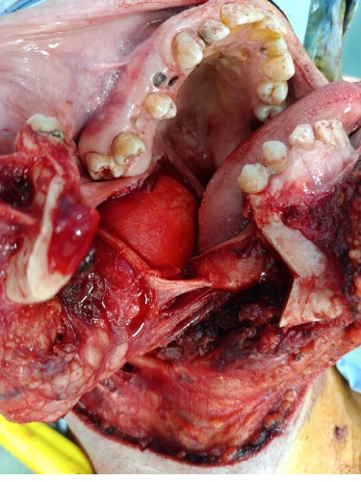
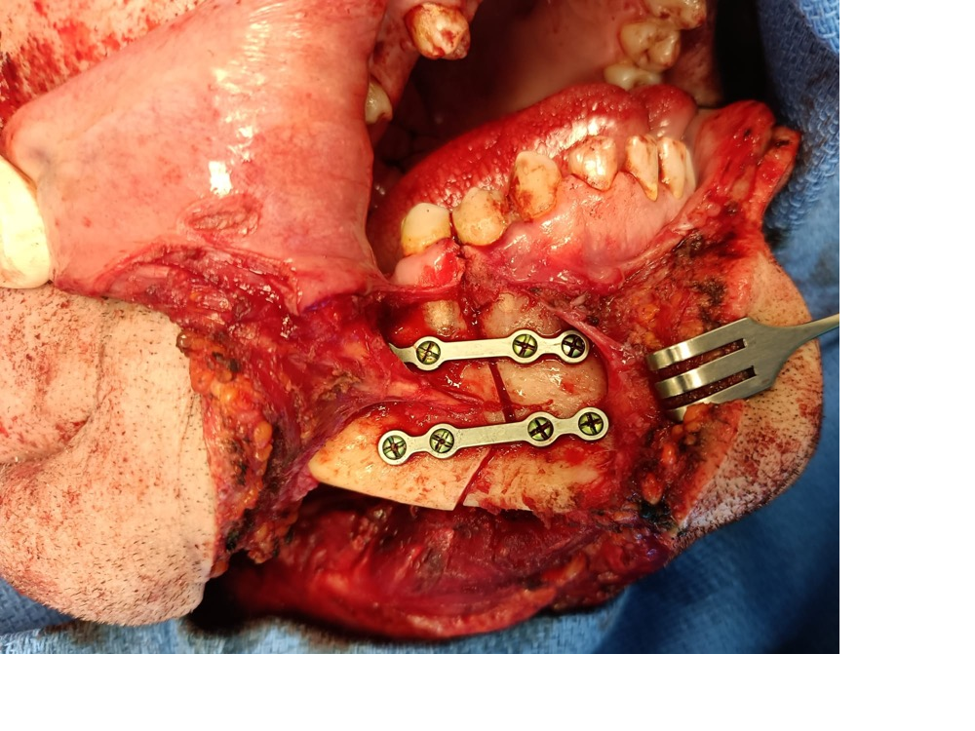

Massive Parapharyngeal Solitary Fibrous Tumour – Surgical Management and Literature Review
1
1
1
1
1
1
1
1
1
1
S. Celli , KMA. Rahman , E. Finnegan , H. Alsubaie , J. Hintze , I. O'Riordan , J. Kinsella , P. Lennon , C. Timon , C. Fitzgerald
1
Background & Aim
Radiology
Results
Conclusions
Solitary fibrous tumours (SFT) are rare. They have an
Preoperative Head and Neck MRI revealed an 8
We
provided
a
detailed
clinical
overview
of
pre
SFT are rare neoplasms of the head and neck,
incidence rate of 1 per 1,000,000 per year with 6-18%
centimetre, heterogeneous right-sided submucosal
to
outline
surgical
planning
and
technique
used
to
particularly in the parapharyngeal space. Given their
arising in the head and neck region.
1,2
We describe
soft tissue lesion extending from the posterior nasal
rarity,
viable differentials
include
schwannoma,
the largest reported SFT in the parapharyngeal space
based on a literature review of this pathology.
space to the level of the epiglottis. The lesion
extended cranially towards foramen ovale. No obvious
tumour. The patient did not exhibit any functional or
peritonsillar
neurofibroma.
abscess,
paraganglioma,
or
expansion was noted. Some fat remained within the
neurological deficits post excision. He underwent
adjuvant radiotherapy treatment. There has been no
Case Study
right parapharyngeal space, and the pharynx was
of
recurrence
or
post-operative
This patient was a self-employed builder without a
narrowed. Per radiology, it was suggested that this
.
history
of
tobacco
abuse
or
of
excess
alcohol
intake,
We performed a retrospective chart review of a forty-
lesion
arose
anterior
to
the
parapharyngeal
space
.
He
denied
any
known
drug
or
environmental
allergies
.
eight year old gentleman who presented with a four
The right medial pterygoid was not identified
Literature review of reported cases using PubMed
Prior
to
this
diagnosis,
he
did
not
have
a
pertinent
month history of globus pharyngeus, dysphonia and
separately.
only
three
other
published
cases
greater
medical or surgical history.
unilateral nasal obstruction. No complaints of
3
dysphagia or odynophagia were noted.
Postoperative Histology
required mandibulotomy for surgical excision. At this
We report the largest case to date in the literature with
9.5 x 4.5 x 6.0 centimetre Solitary Fibrous Tumour.
time, however, no published cases exceeded this
illustrative radiological and intraoperative imaging to
A
transoral-transcervical
approach
with
patient’s tumour dimensions.
describe
the
diagnosis
and
treatment
of
solitary
mandibulotomy was undertaken for surgical excision
fibrous tumours.
of the tumour. The patient recovered well post-
operatively with optimal cosmesis and functional
Acknowledgements
outcome at three month follow-up.
Acknowledgements
are
in
order
for
the
References
Otolaryngology - Head and Neck Surgery department
1 Martin-Broto J, Mondaza-Hernandez JL, Moura DS, Hindi N. A Comprehensive
of Saint James’s Hospital, Dublin.
Review on Solitary Fibrous Tumor: New Insights for New Horizons. Cancers
(Basel). 2021 Jun 10; 13 (12): 2913.
2. Stanisce L, Ahmad N, Levin K, Deckard N, Enriquez M, Brody J, Koshkareva
Y. Solitary fibrous tumors in the head and neck: comprehensive review and
analysis. Head and Neck Pathology. 2020 Jun;14:516-24.
3. Laxague F, Duncan NS, Jurado MG, Bilbao ÉR, Mezzadri NA, Vila JM. Solitary
Fibrous Tumor of the Parapharyngeal Space: Report of 2 cases and a Literature
Review.
Copyright © 2024 Sean A. Celli | scelli@tcd.ie
Nil
CoI

Slide 5
Poster Presentation
IOS Conference Belfast

Slide 6
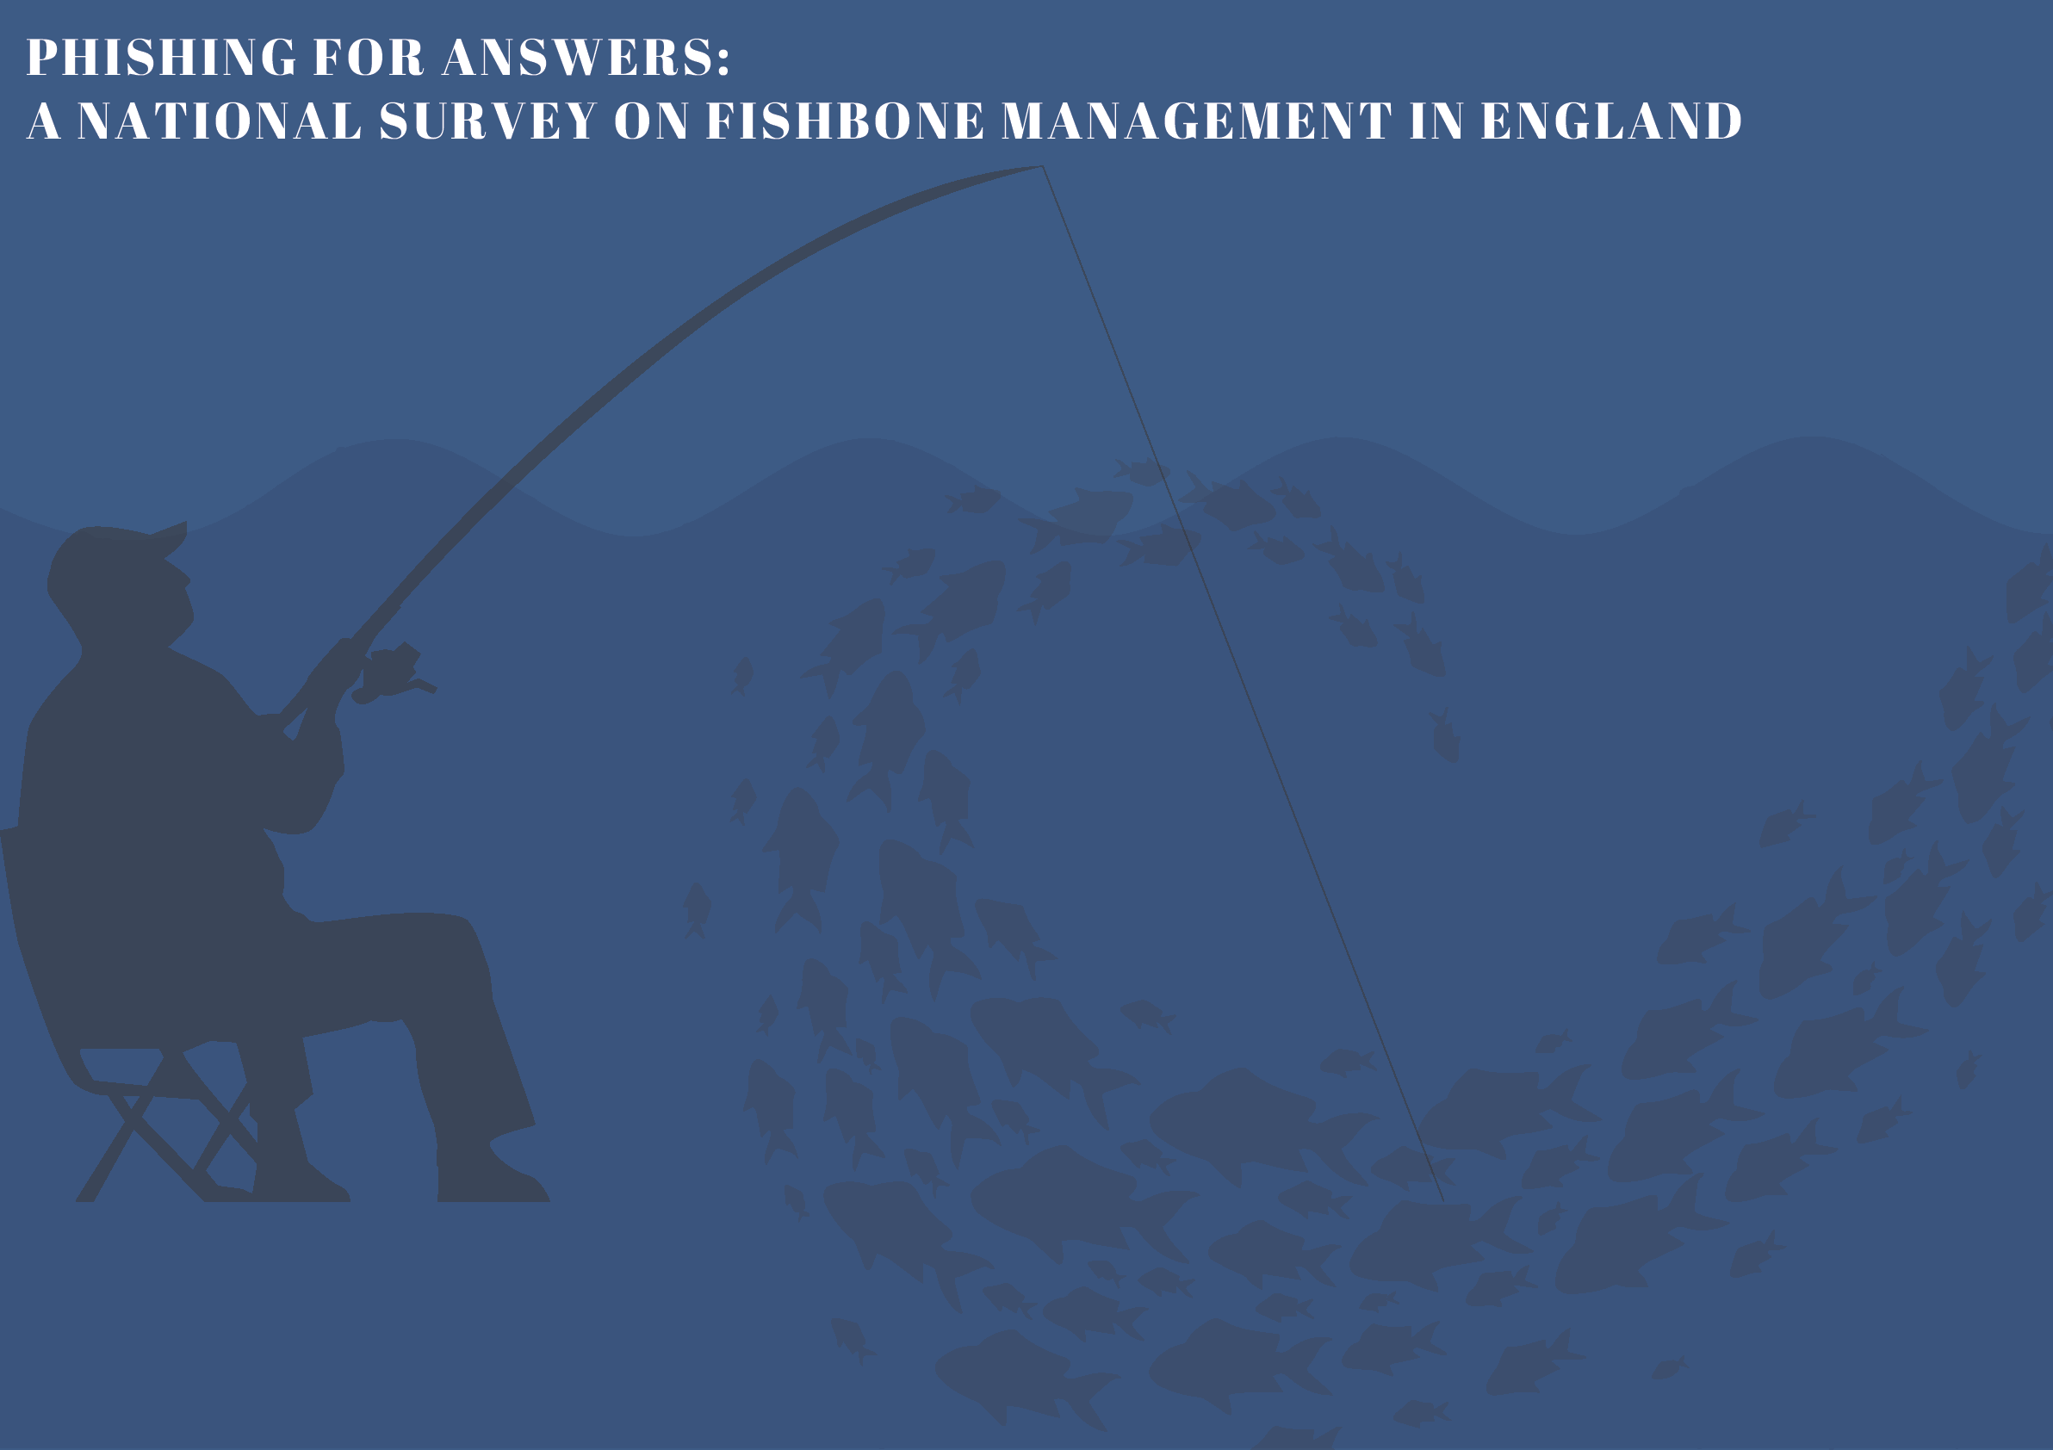



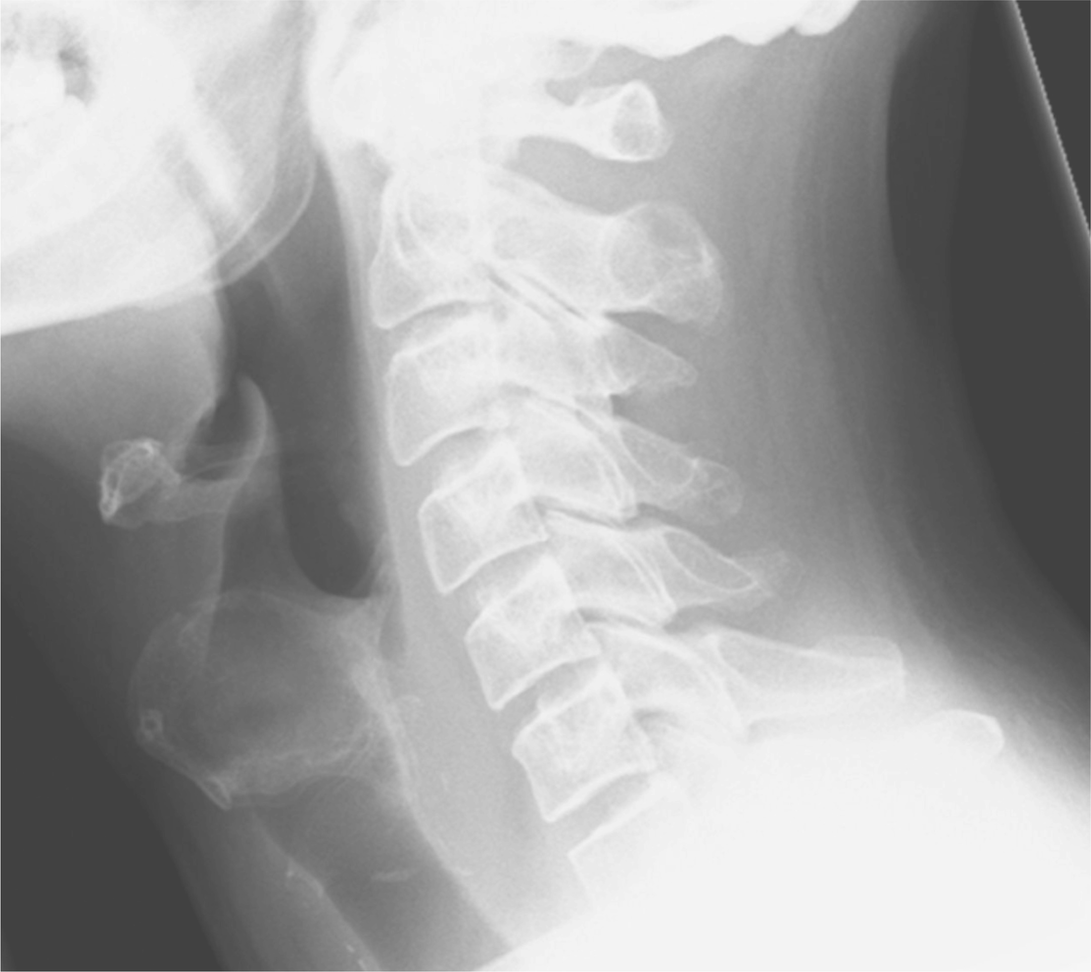




CHEW AM, BUTLER J, MOWAT A, GIBLETT N
BACKGROUND
RESULTS
Fishbone ingestion is a common acute presentation to ENT on-call services(1,2). The symptoms and
radiological findings of lodged bones can be subtle, making their investigation challenging. Little is
Respondents consisted of consultants (11%), registrars (57%), core surgical trainees (26%), GP
trainees (2%) and foundation doctors (4%). 93% were unaware of any current guidelines, 47% were
Anecdotally, the investigation, management and follow up of patient varies significantly.
consultant body. 11% exclusively identified radio-lucent fishbone species, while 66% correctly
identified radio-opaque species. Most commonly found radiological findings included a visible
Most Common Location
fishbones were most commonly lodged in the tongue base and palatine tonsil. Most common
symptoms included odynophagia, dysphagia and unilateral neck pain. The most commonly
8%
9%
Radiological Findings
47%
36%
Palatine Tonsil
To ngue Base
Cricopharyngeus
Other
Loss of cervical lordosis
Oesophageal
Foreign Body
Surgical
Emphysema
Soft Tissue
Swelling
Upper
Oesophageal Air
Loss of Cervical
Lordosis
METHODS
Confidence in managing
fishbone foreign body
Awareness of Guidelines
A 12 question survey was distributed to ENT clinicians of different seniorities via surveymonkey.com.
53 responses were received. The mean response time was 3 minutes and 12 seconds.
7%
Complications
No
54%
Yes
46%
Cons
29%
Non-cons
17%
93%
Yes
No
CONCLUSIONS
Our survey results indicate that practice in this area is inconsistent amongst even senior clinicians.
The high rate of complications arising from such cases reinforces the importance of correct
Odynophagia
Dysphagia
Regurgitation
Dysphonia
Chest Pain
Back Pain
Neck stiffness
clinicians’ confidence in managing fishbone ingestion.
Breathing difficulty
Unilateral neck pain
Soft tissue swelling
REFERENCES
1.Awad, A. and ElTaher, M. (2017) ‘ENT foreign bodies: An experience’, International Archives of Otorhinolaryngology, 22(02), pp. 146–151. doi:10.1055/s-
0037-1603922.
13(4), pp. 394-399

Slide 7
Poster Presentation
IOS Conference Belfast

Slide 8

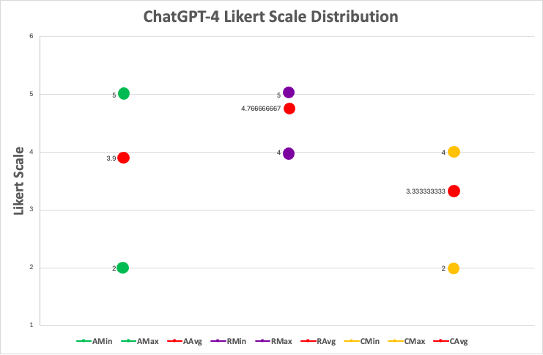
Evaluating adherence of ChatGPT-4 to ENT UK Guidelines in
Otolaryngology Emergencies
KAYE-COYLE Hannah, WATERS Caitlin, JONES Holly, ALY Moustafa, SUBRAMANIAM Thavakumar
Galway University Hospital, Newcastle Road, Galway City, Galway
Background
Results
ChatGPT has been a topic of medical research since
ChatGPT-4 should not
• ChatGPT-4 achieved a Cronbach’s alpha value
its introduction in 2022, demonstrating potential as
of 0.73, indicating an acceptable consistency
as a first line advisory tool in managing ENT
a clinical resource in various specialties. This study
replace specialist
aims to evaluate ChatGPT-4's adherence to
consultation in managing
• Accuracy variance: 0.92
guidelines set by the British Association of
• Indicates a number of scores rating accuracy
Otorhinolaryngology (ENT UK) in emergency
ENT emergencies.
deviate from average value
situations.
• Completeness variance: 0.43
• Largely consistent results but variance
indicates some outliers which skew
consistency
• Relevance variance: 0.19
• Indicating high consistency in responses. The
Methods
scores for rating relevance were high for all
vignettes.
• Thyroid haematoma and foreign body ear
• ChatGPT-4 was presented with ten vignettes
vignettes achieved the lowest performing areas
across all criteria assessed
simulating common ENT emergencies.
• Vignettes were based from the perspective of a
clinician and those that were freely accessible on
Table: Distribution of responses to vignette based on Likert Scale for information provided by Chat-GPT
Conclusion
ENT UK
when assessed for accuracy, relevance and completeness..
• The vignettes were tested three times (N = 30) to
5 strongly agree, 4 agree, 3 neutral, 2 disagree, 1 strongly disagree with responses provided.
assess the model's consistency.
Vignettes provided to ChatGPT-4: “My patient has _____”
• ChatGPT-4 was found to consistently relevant
• Responses were evaluated based on their
Epistaxis
Nasal bone fracture
responses
accuracy, relevance, and completeness against
Acute mastoiditis
Quinsy
information varies depending on the clinical
emergency being managed.
ENT UK guidelines.
Nasal foreign body
Sudden sensorineural hearing
loss
• Cronbach’s alpha was used to measure internal
Foreign body ear
Paediatric stridor
in ENT but should not replace specialist
consultation in managing ENT emergencies.
consistency, with results on a five-point Likert
Thyroid haematoma
Septal haematoma
scale.
foreign body ear management
References
hannahkayecoyle23@rcsi.ie
ENT UK. Available from www.entuk.org

Slide 9
Poster Presentation
IOS Conference Belfast

Slide 10





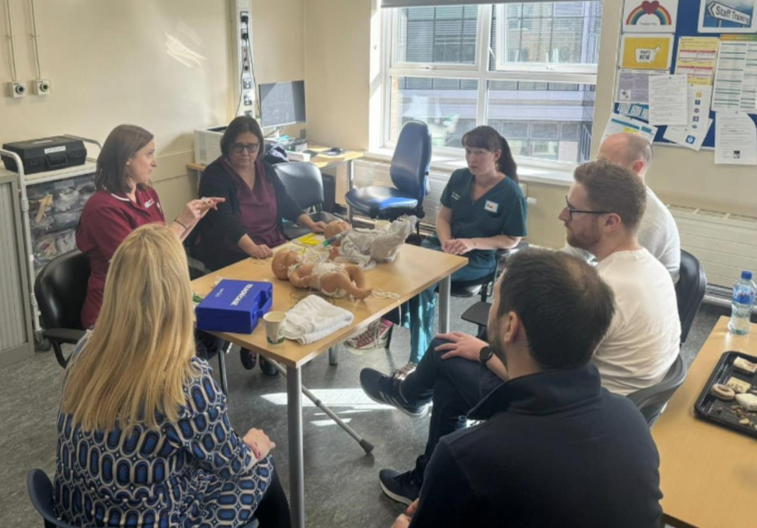



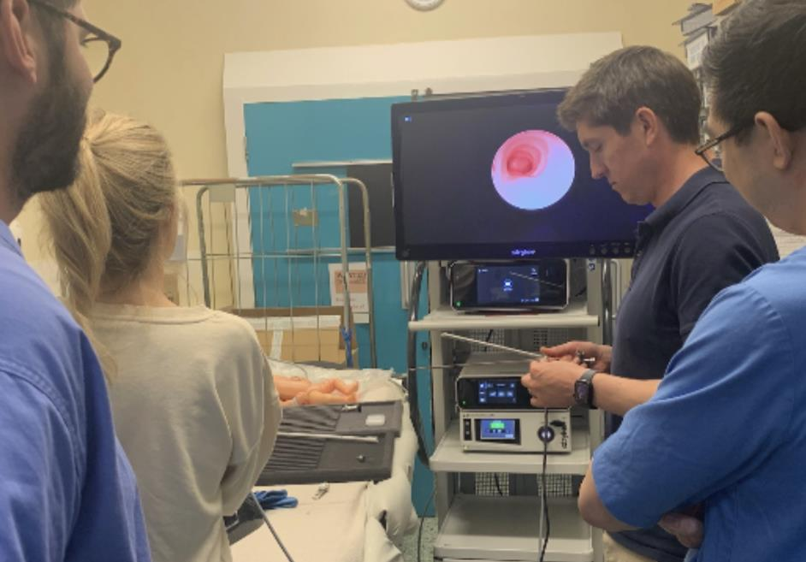
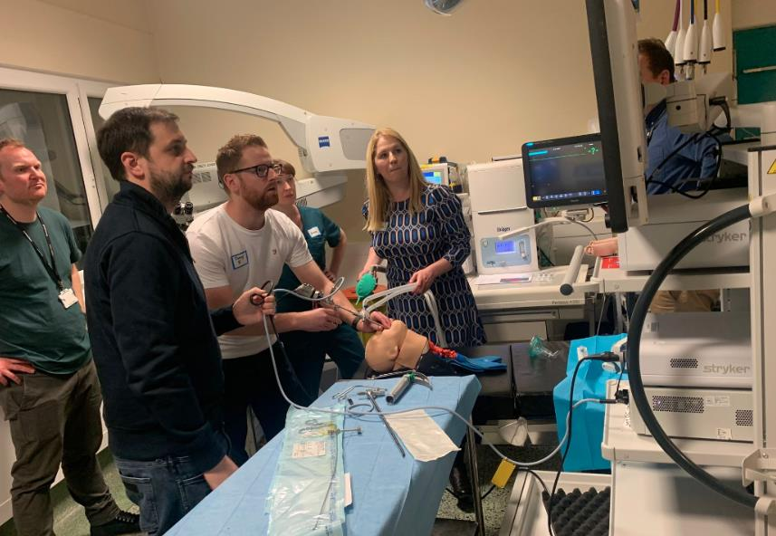





A Revolutionary Collaborative ENT and Anaesthetic Trainee Airway Course:
Utilising Novel Virtual Reality and Augmented Reality Technology
1
1
1
1
1
2
2
2
3
G Donaldson , J Bodels , C Jackson , K Trimble , L McCadden , S Marcus , E Lappin , T Moore , B Maxwell
1
Royal Belfast Hospital for Sick Children/ENT department, Royal Victoria Hospital, Belfast
Department of Anaesthesia, Royal Victoria Hospital, Belfast
RESULTS
2
3
INTRODUCTION
o Regarding formal feedback, those participants that felt
‘very confident’ or ‘extremely confident’ in managing a
Percentage of ENT/Anaesthetic trainees that felt
confident discussing a difficult airway case with the
o The introduction of virtual reality (VR) within healthcare
and specifically within simulation-based education is a
paediatric inhaled airway foreign body improved from 0%
100%
opposing specialty
100%
to 83%.
90%
80%
o Participants that felt ‘very confident’ or ‘extremely
confident’ in managing paediatric and adult tracheostomy
80%
novel opportunity to enhance the care of our complex
70%
60%
airway patients.
50%
45%
emergencies improved from 10% to 63% and 50% to 100%
40%
o ENT and anaesthetic teams frequently manage airway
emergencies out-of-hours, yet our airway teaching
30%
respectively.
20%
20%
o Afterwards, 100% of trainees were either ‘very familiar’ or
‘extremely familiar’ with tracheostomy emergency
10%
programs have historically been delivered separately.
0%
Before Session
After Session
There is a recognised need for both specialties to train
algorithms.
ENT
Anaesthetics
together to develop team-working skills and share
knowledge when managing difficult airways.
Percentage of trainees that felt ”very confident” or
o With regards to skills acquisition, those participants that felt
‘very confident’ or ‘extremely confident’ in performing
o We aimed to introduce a pioneering collaborative ENT and
anaesthetic trainee airway teaching course utilising VR.
“extremely confident” managing tracheostomy
emergencies before vs after simulation session
100%
100%
flexible bronchoscopy improved from 50% to 92%.
90%
o ENT trainees’ confidence in discussing difficult airway cases
with an anaesthetic colleague improved from 20% to 80%
80%
METHODS
70%
63%
60%
50%
50%
and for anaesthetic trainees improved from 45% to 100%.
40%
o We present our first regional Northern Ireland
collaborative airway teaching course delivered in
30%
o All participants found the teaching day useful and agreed
that there should be more collaborative ENT/anaesthetic
20%
10%
10%
February 2024 aimed at both ENT and anaesthetic
0%
Before Session
After Session
teaching.
trainees. Delegate feedback was collected and analysed.
Paediatric Tracheostomy
Adult Tracheostomy
o This extensive high-fidelity full day program utilised a
variety of teaching modalities, including:
o With respect to the VR simulation, 50% agreed that VR
scenarios mimicked a real-life scenario better than
mannikin-based sim.
➢VR oculus 3 headsets with both adult and
o 100% found it useful to perform the simulation with a
trainee from a different specialty.
paediatric tracheostomy simulations and
o 100% felt that VR simulation allowed a safe environment to
learn, highlighting the psychologically safe learning
emergency ‘front of neck access’ scenarios
in-built. An additional multi-player function
environment that often limits conventional sim teaching.
allowed cross-specialty team working.
➢Orsim bronchoscopy simulators and
pioneering flexible nasendoscopy
technology recreating difficult
endotracheal intubation.
DISCUSSION
➢An emergency ‘front of neck access’
simulation station utilised a bespoke
Incorporating VR into airway teaching programs can
mannikin to recreate real-time tactile
enhance and improve emergency tracheostomy
feedback.
management skills. Our ambition is to run this
➢A collaborative paediatric inhaled foreign
collaborative airway day on an annual basis with the
body moulage put our delegates through a
introduction of new and exciting technologies in the
comprehensive scenario from A&E to our
coming years. We have interest from 3D printing
own ENT theatre suite.
companies and other allied health professionals including
maxillo-facial and nursing colleagues.

Slide 11
Poster Presentation
IOS Conference Belfast

Slide 12




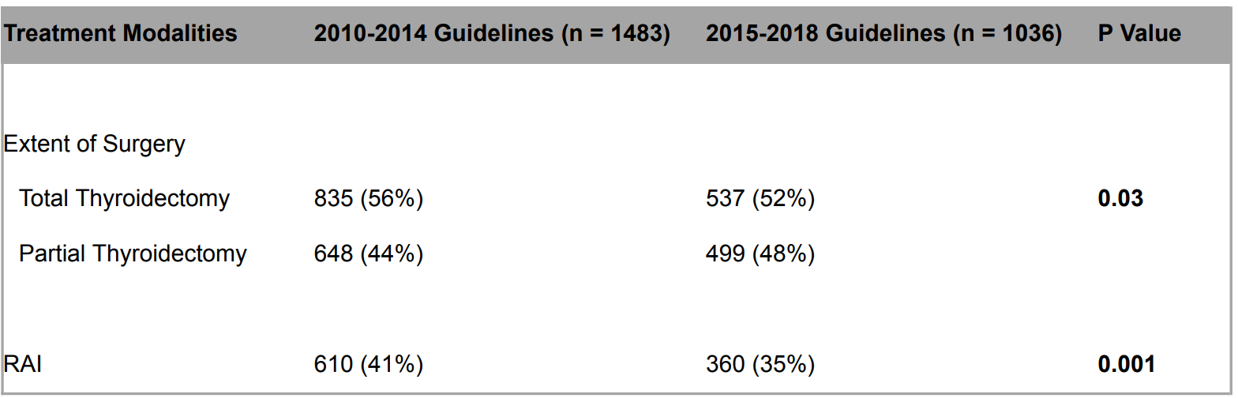
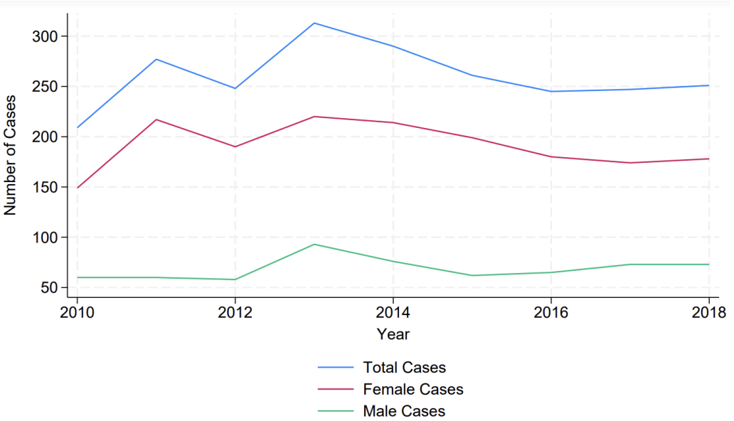
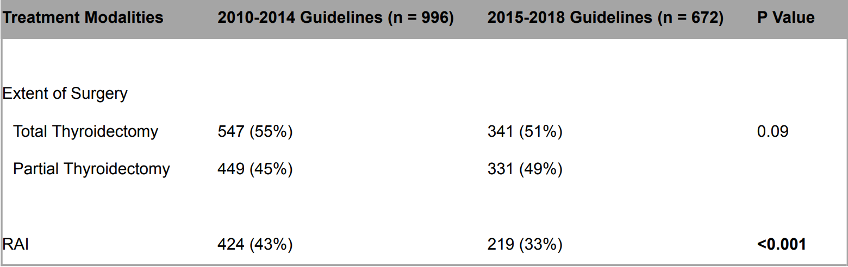
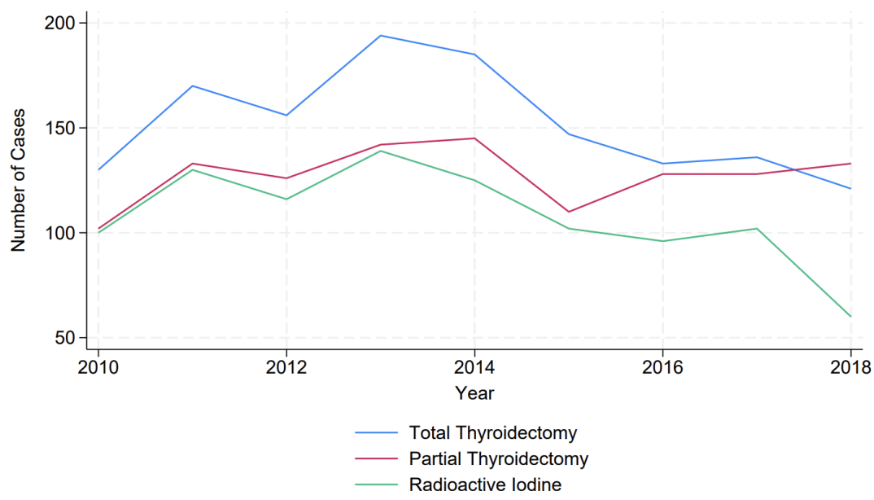
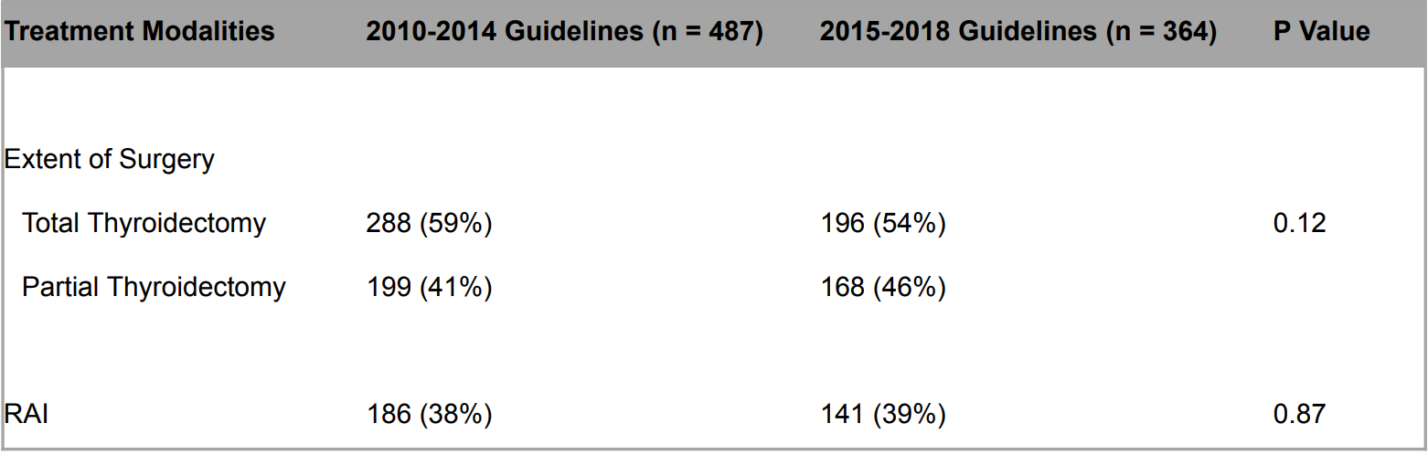

Impact of the 2014 BTA and 2015 ATA Guidelines on
the management of thyroid cancer in Ireland
Anahita Khoshnoud, Dr. Eoin F. Cleere, Aline Brennan, Mr. Neville Shine, Mr. Robbie Woods, Prof. James P. O’Neill
Introduction
Affiliation 1, Affiliation 2, Affiliation 3
Results
In the past 30 years, increased detection has exponentially
increased the incidence of thyroid cancer . In contrast, mortality
from thyroid cancer has remained relatively static, indicating we are
detecting subclinical disease .
1
1
Given the excellent prognosis of disease, it was recognized that
thyroid lobectomy was sufficient treatment for most patients, and
post-operative RAI treatment did not improve disease free survival .
In this context, the 2014 British Thyroid Guidelines and 2015
American Thyroid Guidelines acknowledged over detection of
subclinical disease and reduced treatment guidelines in low and
intermediate risk cases .
2
Ta b l e 1 . Differences in Treatment Modalities for C73 Thyroid Cancer in
Ireland over time. P-value using chi-square (x ).
2
3
Figure 1. Number of cases presenting with Thyroid Cancer (C73) each year
2010-2018
AIM
To determine the effects of the updated 2014 British Thyroid
Guidelines (BTA) and 2015 American Thyroid Guidelines (ATA) on
the treatment approach of thyroid cancer in a Irish cohort.
Ta b l e 2 . Differences in Treatment Modalities for C73 Thyroid Cancer in
patients aged <55 inIreland over time. P-value using chi-square (x ).
2
Methods
A retrospective evaluation of patients with thyroid cancer was
performed using data from the National Cancer Registry of Ireland.
Data extracted included total number of patients diagnosed with
thyroid cancer (data code C73), and total case numbers categorized
by three main treatment modalities–partial thyroidectomy, total
thyroidectomy, and radioactive iodine (RAI) therapy–between the
2010-2018.
Figure 2. Thyroid Cancer (C73) case numbers undergoing total thyroidectomy, partial
thyroidectomy, or radioactive iodine (RAI) treatment each year 2010-2018
Ta b l e 3 . Differences in Treatment Modalities for C73 Thyroid Cancer in
patients aged >55 in Ireland over time. P-value using chi-square (x ).
2
Discussion
Conclusion
Patient data was stratified according to implementation timelines of
the updated 2014 BTA and 2015 ATA guidelines in Ireland. Date
ranges used to stratify the data were 2010-2014 and 2015-2018.
In Ireland, following publication of the updated BTA and ATA
guidelines, there was an overall significant decrease in the
proportion of patients undergoing surgery having a total
thyroidectomy in the treatment of thyroid cancer and also a
decrease in RAI use.
In Ireland, following publication of the BTA and ATA guidelines, there
was a significant decrease in total thyroidectomy and RAI use in the
treatment of thyroid cancer.
To provide data stratification for high risk patients according to AJCC
staging system, both 2010-2014 and 2015-2018 groups were further
divided by age into cases <55 years of age and >55years of age .
References
4
significant decrease in use of RAI, while no significant change
was seen in surgical interventions
1. Bray F, Laversanne M, Sung H, et al. Global cancer statistics 2022: GLOBOCAN estimates of incidence
mortality worldwide for 36 cancers in 185 countries. CA Cancer J Clin. 2024;74(3):229-263. https://
doi.org/10.3322/caac.21834. doi: 10.3322/caac.21834.
Statistical analysis using STATA-18 was performed. Differences
between groups were compared using chi-squared (x ) test. P-
values <0.05 were considered statistically significant. Comparisons
were made for types of surgeries performed and RAI therapy use.
treatment modality were seen in RAI use or extent of surgical
intervention
survival: An analysis of 61,775 patients. Ann Surg. 2014;260(4):601-7. doi: 10.1097/
SLA.0000000000000925.
2
Haugen BR, Alexander EK, Bible KC, et al. 2015 american thyroid association management guidelines
for adult patients with thyroid nodules and differentiated thyroid cancer: The american thyroid association
guidelines task force on thyroid nodules and differentiated thyroid cancer. Thyroid. 2016;26(1):1-133. doi:
10.1089/thy.2015.0020.
alter risk determination and management of higher risk patients.
Our study has demonstrated that the updated thyroid guidelines
staging system for differentiated and anaplastic thyroid cancer (eighth edition): What changed and why?
Thyroid. 2017;27(6):751-756. doi: 10.1089/thy.2017.0102.

Slide 13
Poster Presentation
IOS Conference Belfast

Slide 14


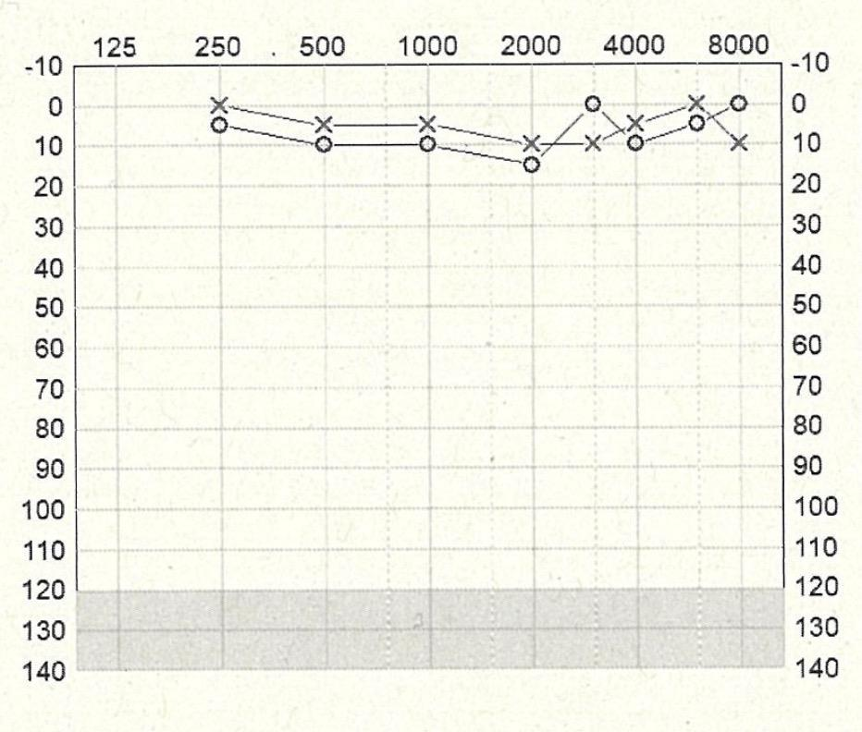
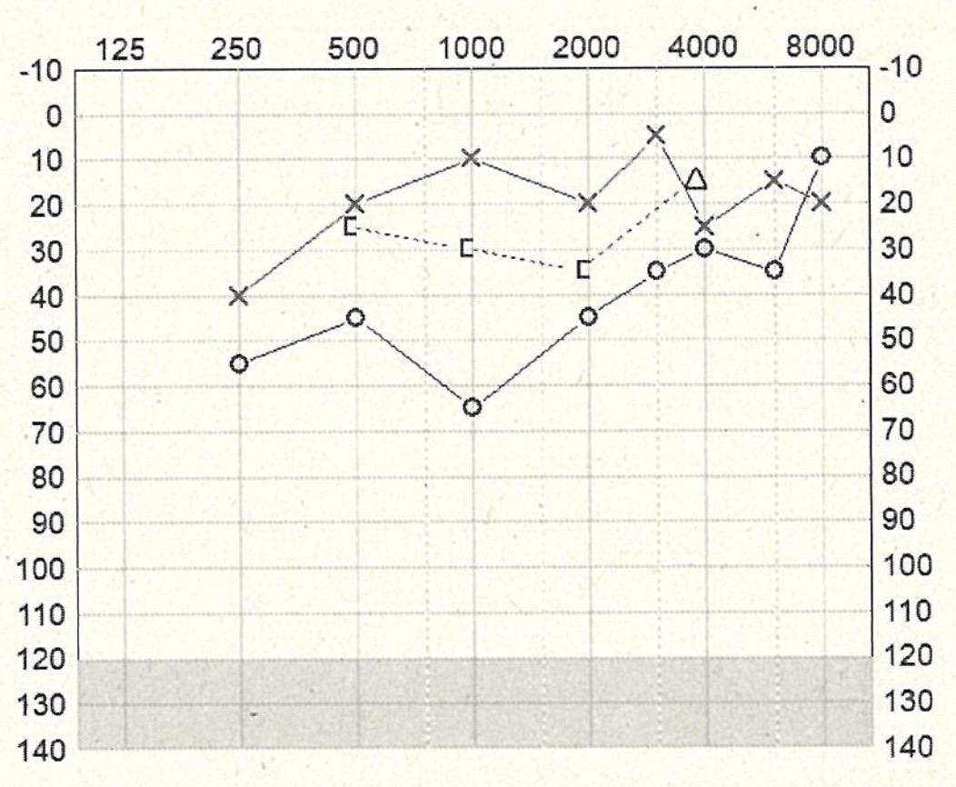
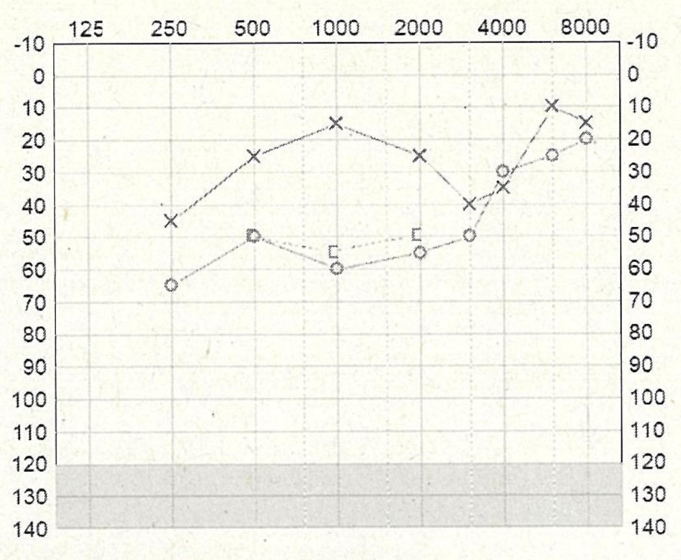



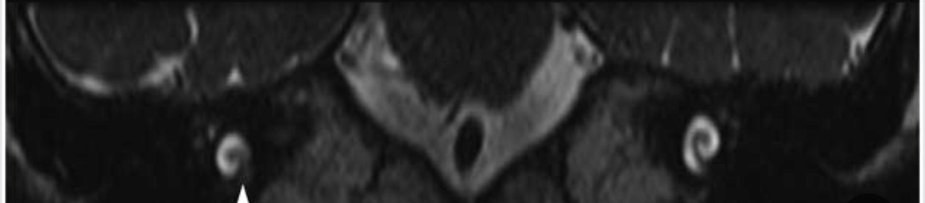
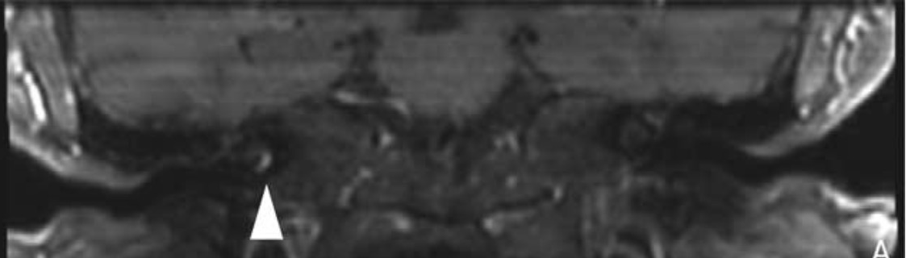
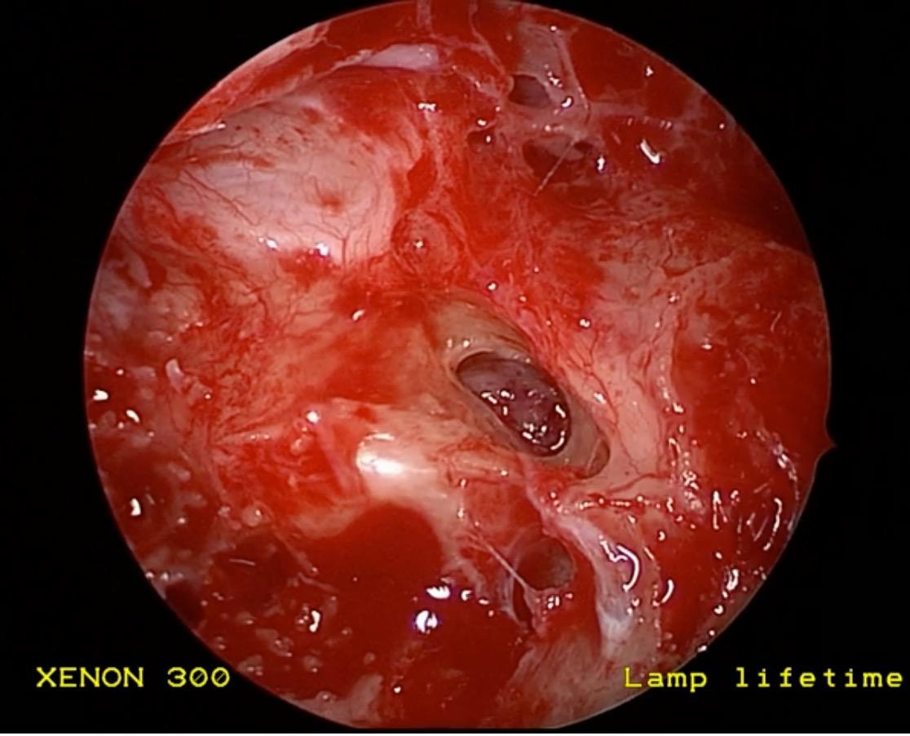

The Natural History of Hearing Loss in Intra-Labyrinthine Schwannomas
Nathaniel McHugh, Samuel MacKeith
BACKGROUND
RESULTS
DISCUSSION
Vestibulocochlear Schwannomas (VS) are a
well-recognised condition usually located
The natural history of hearing loss in ILS
differs from the traditional knowledge of VS.
Patterns of growth typically extend towards
the cerebellopontine angle, however, rarely
element precedes the sensorineural loss in
affected patients.
2018
2021
2023
The aetiology of hearing loss in ILS is
multifactorial with complex interplays
schwannomas (ILS); either within the cochlea
(ICS) or vestibular system (IVS). These are
presenting when the associated sensorineural
hearing loss (SNHL) progresses to profound.
Audiology:
10-30% experience SNHL, understood to be
due to direct mechanical compression of the
auditory nerve and labyrinthine artery causing
In Neurofibromatosis-Type 2 (NF2), ILS may be
diagnosed before development of profound
theory that Schwann cells produce toxic-
metabolites which alter the micro-
ear is believed to cause conductive hearing
loss (CHL).
damage. This is supported by the fact non-
growing and smaller tumours may develop
Our primary aim was to review the natural
history of hearing loss in affected patients.
T1 Weighted with Gadolinium:
Discrete gadolinium enhancement
T2 Weighted MRI IAM:
Right Intra-cochlear filling defect
The conduction deficit is believed to be
secondary to the dampening effect of the
METHOD
reduction of movement of inner ear fluid by
tumour blockage. It has also been correlated
A retrospective chart review of patients with
NF2 was undertaken in Oxford University
Two patients with Intra-Cochlear
Schwannomas that presented with a
WHAT NEXT?
were included. Co-occurring ear pathology
was out-ruled.
Future treatment options for this variant of VS
may differ from current practice. Further
research into this early audiological finding,
Serial audiograms were compared. Intra-
operative clinical photo documentation was
also reviewed.
potentially identify it as a prognosticator
mandating earlier surgical or systemic
Intra-Operative Photo Documentation
Mass extruding from round window

Slide 15
Poster Presentation
IOS Conference Belfast

Slide 16

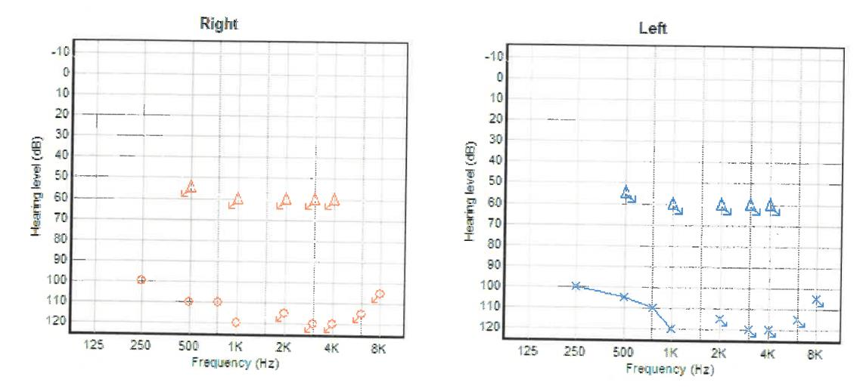
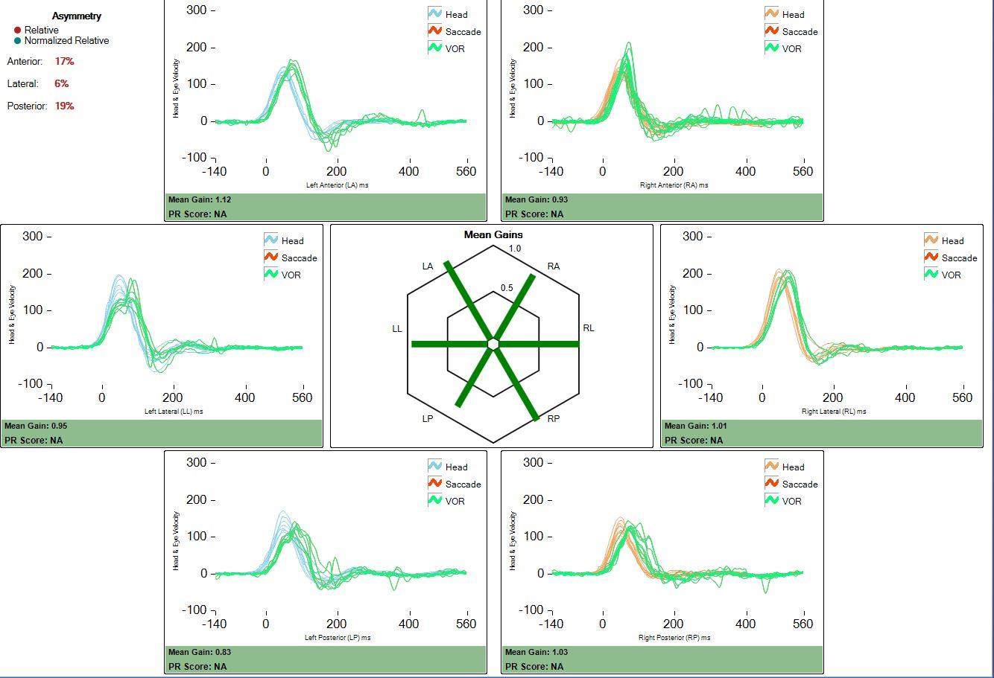
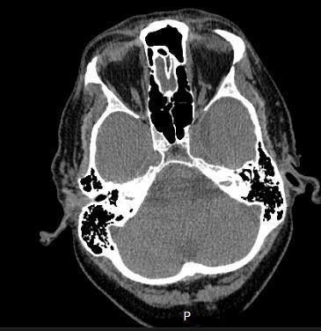
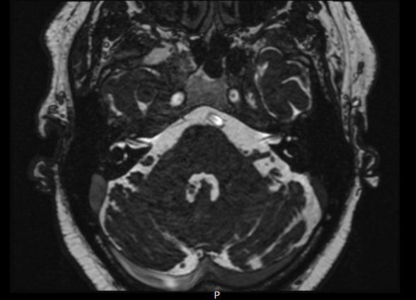
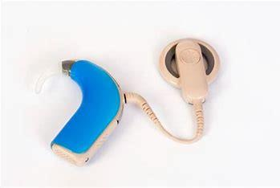
The diagnostic conundrum of an adult with iron deficient anaemia presenting with bilateral profound sudden
sensorineural hearing loss. A case report and literature review.
G. E. McCorkell
1
and E.J. McNaboe
1.
1. Otolaryngology department, Craigavon Area Hospital, Portadown.
Background
Clinical findings
Discussion
Sudden sensorineural hearing loss (SNHL) is defined as a rapid decline of 30db or
On examination, he appeared pale with a normal ENT examination. His cranial nerves I-XII were intact. A head impulse test showed no
nystagmus. A pure-tone audiogram (PTA) showed thresholds of 100+db bilaterally (figure 1) and type A tympanograms with normal
A meta-analysis by Mohamed et al of 344, 080 individuals showed IDA was
more, in at least 3 contiguous audiometric frequencies within a 72hour period . It
1
stapedial reflexes. He had a 0% AB word score bilaterally. A video head impulse test (VHIT) figure 2) showed minimal right posterior
gain, possibly caused by covert saccades, otherwise normal. In the absence of confirmed aetiology, he was admitted for empirical
treatment and investigations.
significantly (p=0.03) associated with SNHL, in keeping with this unusual
presentation . Schieffer et al similarly demonstrated the prevalence of
usually occurs unilaterally, with 90% of cases being idiopathic and affects 5-27 per
8
hearing loss in children with IDA was 3.05% compared to 1.7% without IDA .
100,000 people annually
2,3
.
11
Using rat models, Sun et al also induced SNHL in growing rats with an iron-
deficient diet .
Bilateral SNHL is rare and represents in less than 4.9% of cases
4,5.
It is mainly associated
Investigations:
12
with serious systemic conditions and can be a “red flag” for underlying sinister
Serum investigations demonstrated results compatible with IDA (table 1). All autoimmune and viral screens were normal (CMV, EBV
The mechanism linking IDA and SNHL is uncertain. A possible hypothesis
3
diseases. Some reports demonstrate bilateral SNHL as the first manifestation in male
and syphilis). There was no evidence of sickle cell or thalassemia traits. Radiological investigations included MRI of head and Internal
includes; the cochlea is only supplied by the labyrinth artery it is highly
6
gastric cancers and meningeal carcinomatosis . It has also been associated with drug
auditory meatus, CT temporal bone and CT angiogram of the head. There was no structural abnormality or evidence of acute infarct.
vulnerable to ischaemic damage caused by impaired oxygen carrying
3
toxicity, vascular and autoimmune conditions .
Cerebrospinal fluid (CSF) analysis was also normal. A liver ultrasound confirmed liver steatosis. An OGD and colonoscopy with biopsies
capacity with IDA
8,12,13
. However, in this case, bilateral cochlea infarction in
Iron deficiency anaemia (IDA) accounts for half of anaemic cases worldwide and is
was also normal.
the absence of radiological evidence would be unlikely. Moreover, children
caused
by
insufficient
dietary
intake/absorption
of
iron,
or
blood
loss
from
Figure 1: Pure tone audiogram, on day 19 from symptom onset
Figure 2: Video Head Impulse Test
are also less likely to be at risk of ischaemia so other non-vascular
urinary/gastrointestinal tracts
7.
A meta-analysis identified the odds of SNHL was 55%
:
mechanisms should be explored.
8
higher in patients with IDA . It has also been reported that unilateral SNHL was more
Animal studies have demonstrated IDA alone can affect the cochlea
prevalent in adults and children under 60 years old with IDA, although the mechanism
including: strial atrophy; reduction of spiral ganglion cells as well as peri-
remains unclear
9,10
.
oxidative damage to the inner cells through altering succinic dehydrogenase;
A literature search of Pubmed, Medline, Embase and Google Scholar did not identify
any previous published cases of bilateral profound SNHL with IDA. Two cases have
and perioxidase activity
12,14
. This can permanently impact the stereocilia of
the inner and outer hair cells
14,15
. Iron is a critical element for maintaining
been reported with sickle cell disease
4,11
.
metabolic requirements of neuronal tissues and serves as a cofactor in
neurotransmitter metabolism, DNA synthesis and nerve myelination .
16
Objectives
Figure 1: This image shows profound hearing loss with no responses at 90db bilaterally.
Studies show that iron deficiency can alter myelin production by impairing
energy activity, which could affect conduction velocity in the auditory nerve
causing hearing loss .
This
case
report
illustrates
the
presentation,
diagnosis
and
subsequent
Table 1: Serum results.
17
profound SNHL.
Blood test
Result
Normal values
Haemoglobin
7.8g/dl
13-17g/dl
Other aetiological causes in this case were also considered. There is growing
Early identification and treatment with oral supplements could prevent future hearing
impairment .
Figure 2: This VHIT demonstrates equal eye movements
evidence alcohol consumption is a risk factor for SNHL, although evidence
7
Haematocrit
0.246l/l
0.40-0.50l/l
remains inconsistent. A systematic review and meta-analysis by Quian et al
found a positive association of alcohol and SNHL in only nine of nineteen
Mean Corpusc.
Volume (MCV)
96.1fl
83-191fl
studies
primarily
due
to
lack
of
differentiation
of
confounding
factors
such
as
chronic noise exposure in study populations . Alcohol has mainly been
Case report
associated
high
frequency
hearing
18
Iron
5.8uumol/l
10-30umol/l
with
loss
over
3
kHz
19,20
.
Additionally,
a
A fifty-five year-old Caucasian male developed simultaneous sudden onset of bilateral
few cases of bilateral SNHL with alcohol consumption are reported, however
SNHL within 48 hours and complete loss by day ten with associated bilateral tinnitus
Table 1: highlights iron deficiency anaemia. All other serum tests were normal.
all cases describe symptomatic onset within 24hours of consumption and
and
imbalance
but
no
true
rotatory
vertigo.
He
commenced
high
dose
oral
coincide with recreational drug toxicity from heroin, narcotics and cocaine at
the same time . With five years alcohol abstinence, it is unlikely to be a
prednisolone with tapering and was referred to ENT.
Figure 3: CT temporal bone and MRI internal acoustic meatus findings
20
A
B
confounding factor in this case.
He denied any recent trauma, infections, recreational drug use and no risk factors were
Conclusion
identified in a sexual history. He reported weight loss but denied melaena or
This case presents a rare entity of bilateral profound SNHL in association with IDA.
Bilateral SNHL is usually characterised by more severe degrees of hearing loss and
haematuria. His medical history included hypertension, subarachnoid haemorrhage in
2020 and falls. He was taking clopidogrel, pantoprazole and iron replacement. Socially,
3,7
.
he smoked sporadically and had a history of excess alcohol but had been teetotal for
over five years. He lived alone with a poor diet, which was likely the cause of his IDA.
Serum iron profiles should, therefore, be included in baseline assessments of
patients presenting with acute SNHL and early supplemental iron therapy initiated in
References;
Otolaryngology Head and Neck surgery 146 (3s_supp): S1-s35.
2) Chandrasekhar, S.S. et al (2019) Clinical practice guideline: sudden hearing loss (update). Otolaryngol Head Neck Surg, Aug:161(1_suppl0:S1-S45.
it is hoped early prevention may help to reduce the burden of hearing loss in the
future. Unsuccessful cases of bilateral profound SNHL should be referred early for
3)
Sara, S.A. et al. (2014) Bilateral sudden sensorineural hearing loss: review. The journal of laryngology and otology 128: (Suppl.1) S8-S15.
4)
Mace, A. et al. (2009) Bilateral profound sudden sensorineural hearing loss presenting a diagnostic conundrum in a child with sickle cell anaemia. The journal of
Laryngology and Otology 123;811-816.
cochlear implantation to optimise the patient’s quality of life.
5) Fetterman BL, Luxford WM, Saunders JE (1996) Sudden bilateral sensorineural hearing loss. Laryngoscope 1(06):1347–50
6) Rakusic, Z. (2015) Sudden bilateral hearing loss in gastric cancer as the only symptom of disease. Onco Targets and therapy 8: 1285-1289.
7) Chung et al. JAMA Otolaryngology Head and neck Surgery (2014) Sudden Sensorineural Hearing Loss Associated with Iron Deficiency Anaemia, A population-
8)
Based Study.
Figure 3: A shows a CT temporal bone and B shows and MRI IAM. These demonstrate no structural abnormality. However multiple small chronic cerebellar and
cerebral infarcts were noted with generalised atrophy.
Mohammed, S.H. et al (2019) Association of anaemia with senorineural hearing loss: a systematic review and meta-analysis. BMC Research Notes 12:283.
9) Chung S-D. et al (2014) Sudden Sensorineural hearing loss associated with iron-deficiency anaemia. JAMA Otolaryngology Neck Surg 140(5): 417.
10) Schieffer,K. et al (2017) Iron deficiency anaemia is associated with hearing loss in adult population. JAMA 143(4)L350-354.
11) Sun et al. (1987) Iron deficiency and hearing loss. Experimental study in growing rats. ORL: Journal for oto-rhinolaryngolgy and its related specialties, 49,118-122.
12) Schieffer K. et al (2017) The relationship between iron deficiency anemia and sensorineural hearing loss in the paediatric and adolescent population. Research
Treatment:
Article.
13) Suga, F. et al (1970) Experimental micro-embolisation of cochlear vessels. Archives of Otolarynology 92: 213-220.
Empirical treatment was started immediately which included five consecutive days of methylprednisolone intratympanic injections
14) Sun, et al. (1990) Changes in the cochlear iron enzymes and adenosine triphosphatase in experimental iron deficiency. Annals of otology, rhinology and
laryngology 99, 988-992.
(40mg/ml) bilaterally. Haematology advised to treat his IDA with ferrous fumarate, vitamin K and fresh frozen plasma. His correct
15) Kurioka, T. et al, (2021) Iron deficiency is associated with poor prognosis in idiopathic sudden sensorineural hearing loss. The Journal of Laryngology & Otology
135:508-512.
haemoglobin was 9.9g/dl and iron 55.8umol/l. Unfortunately, a pure-tone audiogram at day five and at three months follow up
16) Zhang, C. (2014) Essential functions of iron-requiring proteins in DNA replication, repair and cell cycle control. Protein cell 5(10): 750-760.
17) Liu, X. et al (2013) Lead exposure results in hearing loss and disruption of the cochlear blood-labyrinth barrier and the protective role of iron supplement.
showed no improvement. He was fitted with hearing aids and referred for cochlear implantation.
Neurotoxicity 39:173-81.
18) NaiboğlluB, et al (2015) Efficacy of multi-modality approach to sudden hearing loss. Kulak Burun Bogaz Ihtis Derg, 25:77-81.
19) Martins, S.J. et al (2011) Meningeal carcinomatosis in solid tumors. Arq Neurop-siquiatr, 69(6): 973-980.
20) Antonopoulos, S et al (2012) Bilateral sudden sensorineural hearing loss caused by alcohol abuse and heroin sniffing. Auris Nasus Larynx 39:305-309

Slide 17
Poster Presentation
IOS Conference Belfast

Slide 18













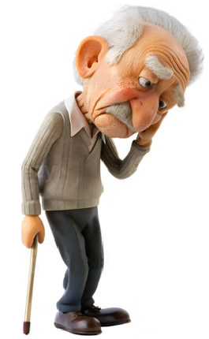





















Evaluating the Impact of a Geriatric Oncology Assessment
and Liaison (GOAL) Service in a Model-4 Irish Hospital
1
1
1
2
2
Van Den Berg N , Cleere EF , Skinner L , Goggin C , Horgan A
1
Department of Otolaryngology - Head & Neck Surgery, University Hospital Waterford, Ireland
CGA Assessment: Case Example
2
Department of Medical Oncology – University Hospital Waterford, Ireland
Background:
SOCIAL ASSESSMENT
ADLs & I-ADLs:
The incidence of head and neck cancers is on the rise, with >50% of patients diagnosed
Referral Pathway
Lives at home with his wife
ADLs: 6/6
over the age of 65. With an aging population, this figure will increase. We evaluated the
House with stairs
Unable to use phone due to lip swelling
impact of establishing the first Geriatric Oncology Assessment and Liaison Service in
Screening:
Vulnerable Elders Survey-13
No formal home supports
Son cooks; does laundry; aids with
Ireland.
Hearing impairment; no hearing aids
medications & finances
Altered Pharmacokinetics
Chronological age:
PSYCHOLOGICAL / COGNITION
Reduced Muscle Mass
Geriatric Depression Scale: 8
Altered Renal & Liver Function
functional status
79-Year-Old Male
Consented to psych-onc referral
Started on Mirtazapine
pT3 pN1 Right Buccal SCC
Mini-COG 4
Why Are Older
Adults Different?
Abnormal Screen
VES-13 ≥3 or G8 ≤14
Normal Screen
FRAILTY
SCORE: 6
PORT December 2023
Moderately frail
Multi-Comorbid Patients
Failure to maintain
homoeostasis under
Recurrence August 2024
PHARMACOLOGY
98% of CA pts ≥65 have x1 co-morbidity
Weakly PD L1 positive
Can increase Mirtazapine
59% have >3 comorbidities
Comorbidities: T2DM, Gout, HTN
Stopped Metformin
Refer for CGA
Fit – Standard of Care
Input from pharm and geriatrician
ECOG performance status
NUTRITION
related toxicity in the older cancer
patient
Mini-Nutritional Assessment: 9
MOBILITY
The GOAL MDT
Baseline weight: 75kg
Walking stick PRN
No oral supplements
No falls in 12 months
Grip strength: 20 kg
Timed-up-go: 10.61 seconds
Geriatric oncology patients are at an increased risk of:
treatment related toxicity
1
st
Irish Geriatric Oncology Clinic
Sit-to-Stand 13.22 seconds
No orthostatic hypotension
OVERALL: High Risk of Significant Chemotherapy Related Toxicity
poorer survival outcomes
Geriatrician
support
Beneﬁts of CGA:
Methods:
Oncologist
2017
2 x CNS
Dietitian
Identiﬁes problems not revealed through traditional oncology assessment
Oncology patients ≥ 70 years were assessed using the Comprehensive Geriatric
Interventions directed at CGA-identiﬁed problems:
Greater likelihood of completing chemotherapy
Assessment (CGA) tool. A pre-treatment CGA, which includes assessment of the
↓ Hospitalisations and ED admissions
↑ Quality of life
following: mobility, cognitive, nutritional, functional, and psychological status, as well as
a comprehensive pharmacological assessment was performed.
2024
Quantify the risk of toxicity
Results:
Over a five-year period (2019-2024), 458 patients were evaluated. Majority (352/458,
Oncologist
Geriatrician
ANP
CNS
Pharmacist
Dietitian
OT
Conclusion:
77%) were diagnosed with gastrointestinal tumours. 15/458 (3.3%) of patients were
Limited information exists on treatment decisions for the geriatric oncology population.
diagnosed with head and neck primaries. This low number reflects local standard
Utilisation of GOAL services provides an enhanced holistic approach to older cancer
operative
protocols
and
funded
referral
pathways.
Informed
treatment
The authors have no conﬂict of interest to declare.
patients. This timely review will allow for extension of this service to all head and neck
recommendations were established using CGA outcomes.
Contact Information: nadiavandenberg@rcsi.ie
cancer patients ≥ 70 years, discussed at our Head and Neck MDT.

Slide 19
Poster Presentation
IOS Conference Belfast

Slide 20

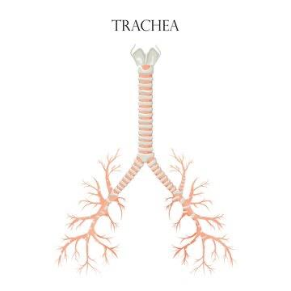
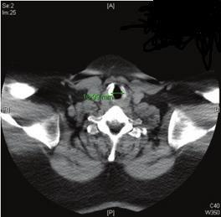
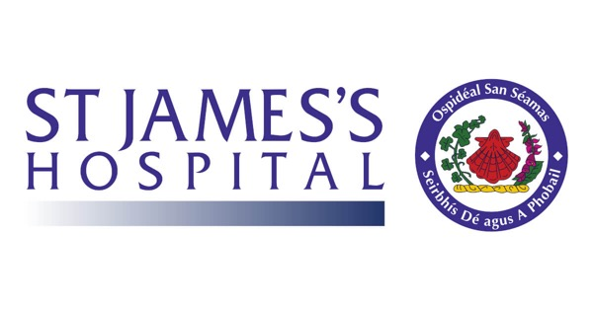

A Retrospective Cohort Study of the Timing & Outcomes of Surgical Tracheostomy
Placement in the National Burns Unit from 2011 to 2024
1,2
1,3
1,3
J . Cronin
, C. McCarrick
, O. Shelley
1.Royal College of Surgeons, Ireland, 123 St. Stephen’s Green, Dublin
2.University Hospital Limerick, Dooradoyle, Co. Limerick
Background
Aim
A tracheostomy is a significant intervention performed to secure airway
management in a substantial proportion of burn patients. Tracheostomy is a
common surgical intervention in burn patients who have suffered a smoke
inhalation injury (SII) and or severe facial and or neck burns. Currently, there
are no guidelines as to the timing of tracheostomies in burn patients
To assess the incidence, timing & complications of surgical
tracheostomies over a 13 year period in the National Burns Unit of Ireland
(n=52). We examined whether there were differences in 3 distinct
associated pneumonia (VAP) & tracheal stenosis.
Methods
Admissions to the
National Burns Unit
• 13-year, retrospective cohort study of all tracheostomies undertaken
intheNationalBurnsUnitfrom March 2011 to January2024.
1. Education was provided to all
stakeholders at various intervals. Firstly,
didactic teaching was conducted at
•
was sourced and corroboratedfromthefollowingsources:
ProspectiveBurnsRegisterfrom2011-2024
rounds. This was followed by an audit
period of two-weeks. Secondly, teaching
EPR(ElectronicPatientRecordSystem)
BurnsTheatreLogbook
anaesthetics journal club. Following this,
an audit period was again conducted.
• Inclusion criteria: patients who underwent a surgical tracheostomy
throughout this thirteen-year period ano sustained an inhalational
Tracheostomies
performed+ SII
Subjectsweredividedintotwogroups:
•
sustainaneckburnthatrequiredgrafting
Group A,
without neck
Group B, with
neck burn
B) Patients that sustained SII and a neck burn which required
grafting
• Tobiasen’s Abbreviated Burns Severity Index (ABSI) and the modified
Bauxscoresonadmissionwereusedaspredictorsofmortality.
•
Age,ABSI,ModifiedBaux,timetotracheostomy,incidenceofmortality,
incidence ofventilator-associated pneumonia (VAP), and incidence of
• A t-test was used to compare the rate of VAP between the early and
latesubgroups,inbothGroupAandGroupB,respectively.
Early
intervention
Late
intervention
Early
intervention
Late
intervention
Results
Figure 1: Characteristics of Mortality subgroup vs Cohort
Tracheal Stenosis
Mortalities (n=8)
Cohort (n=52)
Mortality
•
3 incidences in Group A
Mean TBSA %
Mean Age
46 %
57
35.8%
50
modified Baux score were
associated with the mortality
subgroup compared to the
late post-operative
complication
•
12%
between 3%-
Mean ABSI
Mean Modified
11
114.7
9.3
101.6
Supporting the predictive
value of both scoring systems
Group
A, Early
Group A,
Late
Group B,
Early
Group B ,
Late I
Mean ABSI
Mean Modified
95.5
98.4
104.6
109
Mean days to
tracheostomy
11
12
Ventilator-
associated
Discussion
Higher
complication rate
Early tracheostomy is indicated in those with
a significant inhalational injury to reduce
complications. Higher modified Baux and
ABSI score consistent with higher mortality.
Higher complication rate in late intervention
re VAP, but significance differs between
groups. Early recognition and management
Incidence of
Tracheal Stenosis
1
2
-
-
Incidence of VAP
P-value of VAP in
2
7
2
3
tracheostomy but
significance differs
0.036
0.08
intervention
importance.
Mortality
4
4
Figure 2: Breakdown of Findings by
subgroup
josephcronin24@rcsi.com

